Slide 1
DevSecOps for the Rest of Us!
ASD-F02
Sara Perrott
Sr. Information Security Technology Engineer
BECU
Twitter: @PerrottSara
Notes:
Introduce myself:
Hey everybody,
My name is Sara Perrott, and work at BECU as a Senior Information Security Technology Engineer. My work tends to focus on security centric tools like firewalls, data loss prevention, email security, etc. I should note that the content of these slides and this presentation are my own, and do not represent the opinions of my employer.
I have a confession to make before we get started. I joined the DevSecOps movement very grudgingly at first. I looked at it as more work…like an episode of “Developers gone wild.” By the end of this presentation it is my hope that you will come to the same conclusion that I did. DevSecOps can actually make your life easier…

Slide 2

More Time in the Day
Don’t you wish you had more time?
Time for project work?
Time for training?
Time for lunch?
Time for vacation?
This Photo by Unknown Author is licensed under CC BY-NC-ND
Notes:
Before I embraced a DevSecOps mentality, I was inundated with requests. It seemed like I never had enough time in the day to get my work done. There were the 4-5 projects that I was working on, the training that I needed to get done. Regulatory training, product training, workshops I needed to go to. Add to that the routine manual tasks and my days were packed!

Slide 3

Cloning Technology
Wouldn’t it be great if there were more of you?
Too much manual work
Poor work/life balance
Stress
Burnout
This Photo by Unknown Author is licensed under CC BY-SA
Notes:
It’s impossible to keep up with today’s pace. As companies grow, and we continue to expand our datacenters into the cloud and beyond, IT groups haven’t grown even though they are supporting more systems. A lot of the legacy processes that worked well in the past just don’t work well at scale, mainly because those old processes involved a lot of manual work. All of this manual work leads to a poor work/life balance. You end up having to put in longer and longer days just to get the same amount of work done. Being under so much stress for such a long period of time leads to burnout. Companies are losing very talented engineers because of this issue.

Slide 4

Automation
Imagine if you will…
A ticket is created in your ticketing system for a new server
That ticket kicks off a workflow, and the server is automatically built with the specifications from the ticket
Instead of the server build taking a few hours, it is done within 15-30 minutes
This Photo by Unknown Author is licensed under CC BY-SA
Notes:
So how do we get away from the stress and the manual processes? My new favorite word is automation.
Picture the perfect world where a business unit needs a server provisioned. They create a ticket and select the specs that they need, the operating system, and other software needs. The moment they click on Submit, a workflow is kicked off that uses PowerShell to create the server and install the software that is needed. PowerShell DSC is used to ensure that the server meets all of the organization’s security baselines. So within one hour of clicking on the button, the business user has a secure server built to their needs, that is up to date and secure. And you didn’t have to lift a finger. ☺

Slide 5
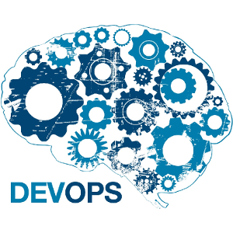
What is DevOps and DevSecOps?
DevOps
Continuous Integration
Continuous Delivery
DevSecOps
Moving Security to the Left
What does this have to do with me?
This Photo by Unknown Author is licensed under CC BY
Notes:
Lets make sure that we are all on the same page before I continue. Who here is familiar with what DevOps is? Ok, what about DevSecOps?
For those of you who didn’t raise your hands, lets do a quick tutorial.
DevOps came about because Development and Operations often had different priorities and weren’t supporting one another. When deadlines weren’t meant finger-pointing started almost immediately. The focus began to shift towards smaller teams and better communication. And then slowly the shift went from large releases that were bound to have errors to smaller and much more frequent deployments of code. This was the birth of DevOps…focus on communication, process improvements and a shift towards these smaller more frequent deployments.
DevSecOps took things one step further. Security was quite often the last thing that people thought about when they were developing code and pushing out products, so Security got the reputation of slowing projects down, or getting in the way of deployment. By moving security “to the left” in the equation, meaning that security was thought about earlier in the process, organizations were able to release products that were more secure and meet their deadlines. Pretty much a win-win for everyone, right?
At this point, you might be wondering what this has to do with you. I’d like you to keep this in mind as the beginning of the idea. Maybe we are building servers with a scripting technology. That’s a great win for a System Administrator who now gets time back in their day. Now let’s automate secure baselines so that our systems can pass any audit you throw at them…HIPAA, PCI-DSS, whatever. That’s a huge win for the Security Administrator too. Your scripts can be kept in a repository like Github so that changes to the script are tracked (think version control). I hope that helps to give you an idea of what we will be discussing here today.

Slide 6

DevOps/DevSecOps is not just for Developers!
This Photo by Unknown Author is licensed under CC BY-SA
Notes:
Show of hands…how many are developers? How many are Sys Admins? Sec Admins?

Slide 7
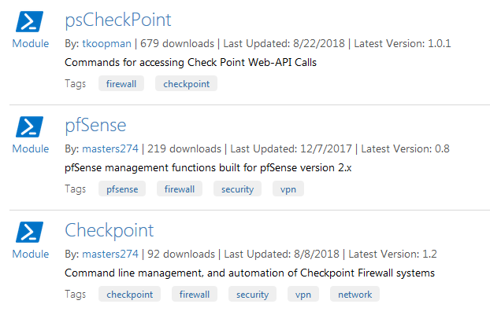
Tools in Your Arsenal-PowerShell
Universal language
Expandable with modules
Product Specific modules: PowerShell Gallery
Tell it how it should be built
Notes:
One of the most powerful automation tools in your arsenal is PowerShell. For the automation example I gave earlier, this is really the tool that starts the process off. Whats great is that this can work for on-premise deployments or cloud deployments. For on premise deployments using Hyper-V you can use it natively. For VMware environments, you have their flavor of PowerShell, called PowerCLI that can do a lot of the provisioning work for you. Azure (via Azure PowerShell) and AWS (via AWS Tools for PowerShell) both support PowerShell scripts.
If you have other devices that you want to use PowerShell on, or you want examples of PowerShell, the PowerShell Gallery is a great place to start. People have taken the APIs provided by vendors and have wrapped them in PowerShell modules. In the example on the slide, you can see the PowerShell modules available to work with CheckPoint firewalls.
STORYTIME:
This is a simple story of automation…one of our easiest wins. I was the administrator for a product that used Apache Tomcat and MySQL on a Windows server. There was a primary server, and a secondary server that needed to be kept in sync with one another. The backup and restore process was very manual and I performed it once a week. One of the biggest problems was that if I was busy or out, then the backup/restore didn’t happen. So using a combination of PowerShell to call the batch scripts and overwrite entries in the database on the restore, and the Task Scheduler in Windows, I was able to take a manual once a week process, and automate it to run every night. Not only does this save me an hour each week, it ensures that the primary server and the secondary are never more than a day out of sync, which for this application is acceptable.

Slide 8

Tools in Your Arsenal-PowerShell Issues
Remote PowerShell
Firewall ports:
WinRM
TCP 5985 (HTTP)
TCP 5986 (HTTPS)
Execution Policy
RemoteSigned
This Photo by Unknown Author is licensed under CC BY-SA
Notes:
Some issues you may encounter when using PowerShell for automation:
Remote PowerShell
Firewall ports: TCP 5985 and 5986: To support remote PowerShell, you need to ensure that WinRM is allowed through the firewall.
Execution Policy: The execution policy could be a dealbreaker if it is set too strict and you are trying to run scripts downloaded from the internet. RemoteSigned is typically sufficient, and requires scripts downloaded from the internet to be signed.

Slide 9
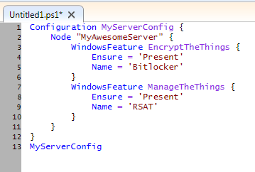
Tools in Your Arsenal-PowerShell DSC
Saved as ps1
Tell it what it is
not how it is
Notes:
Once you have created your resources, you may want to enforce baselines like registry settings, having certain software installed, etc. This is where PowerShell Desired State Configuration (DSC) comes in…it can be used to install roles and features, set registry keys, ensure software is installed and present (things like AV, auditing tools or DLP tools come to mind). What I like most about PowerShell DSC is that it uses such a simple language which can make it very user friendly. In the example on the slide I check to ensure that both BitLocker and Remote Server Administration Tools are installed. All I have to say is ensure that these are present. If they aren’t, DSC will install them.
STORYTIME:
As an information security professional, I like to ensure that the systems in my environment are configured using a secure baseline. We needed a solution that would work on-prem and in Azure…it had to not only find discrepancies from our secure baseline, but also fix them when they were found. So, a few of our System Admins put their heads together and converted the CIS guidelines to a PowerShell DSC script. By taking advantage of the PowerShell DSC script, we know that every server…regardless of who provisioned it is configured according to that same secure baseline.

Slide 10
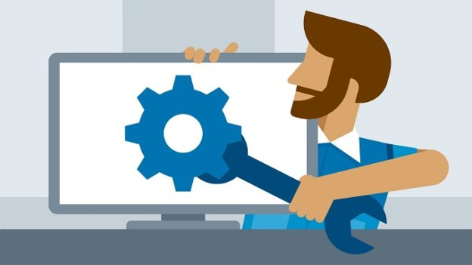
Tools in Your Arsenal-PowerShell DSC Issues
Behavior: Push or Pull
Know the correct names
Roles
Features
Services
This Photo by Unknown Author is licensed under CC BY-NC-ND
Notes:
You need to decide how you want PowerShell DSC to act. There are two models that are in use, push or pull. The setup and configuration for each is different from the other so ensure that you pick the right one for your use case and configure it properly. In a pull configuration, the server being configured “pulls” the config from a local or remote source. In a push configuration, a server is responsible for pushing the configuration out to the server that you want to configure.
When targeting the names of roles, features or services, ensure that you have the correct name for what you are trying to work with. This may seem obvious, but there are plenty of issues where a typo caused problems.

Slide 11


When to use…
PowerShell
PowerShell DSC
Instructions (How)
Vision (What)
This Photo by Unknown Author is licensed under CC BY-NC-ND
This Photo by Unknown Author is licensed under CC BY-SA
Notes:
So you may be wondering when should I use PowerShell vs. PowerShell DSC, since there is some overlap between them. The way I look at it is this… when you want to provide instructions on how to do something, use PowerShell. This may be when you install a server, and you tell it to roles and/or features. Then install a program, etc. PowerShell DSC is my favorite as a security professional, because now I am not giving it instructions on how to become what I want it to be. I simply tell it what I want it to be. Maybe I want it to run Bitlocker. Or maybe I want it to run the Host Guardian Service for Hyper-V. I only have to tell it what I want, not how to become what I want. I love the simplicity of that very much.

Slide 12

Infrastructure as Code
IaC is a methodology-not a product!
Treat systems like software
PowerShell
PowerShell DSC
Templates
Automation/Orchestration Tools
This Photo by Unknown Author is licensed under CC BY-SA-NC
Notes:
In my earlier automation example, I had mentioned being able to go from a ticket in the ticketing system to a fully deployed server…what I was speaking of was Infrastructure as Code. I know some of you might be panicking because I said “code.” Hang in there…I promise I’m not a developer. You need to think of IaC as a process and not as a product. When you think of it that way, you realize that you aren’t tied to doing it in a specific way. You can use PowerShell or PowerShell DSC like I mentioned. You can use REST APIs – if you can browse the interwebs you can use REST API. You can make use of templates within the cloud provider environments, for instance ARM templates in Azure, or CloudFormation templates in AWS. You can also make use of automation and/or orchestration tools to simplify the automation process.
STORYTIME:
The example of the automatically provisioned servers became a reality in my world…by using PowerShell, we are able to build systems based on our ticketing system. End users could request a server, set the specifications needed and the desired location. Assuming it was in the approved range of specifications, the server would automatically be provisioned. A process that previously took days to weeks…now only takes an hour.

Slide 13
Tools in Your Arsenal-REST API
What makes up a REST API?
From F5’s NetOps Training:
Notes:
A REST API call looks very much like something you would type into your browser, in fact you can type it in to your browser if you need to test that your API command is working successfully. It uses HTML commands like PUT and GET. You don’t usually need special ports open to support it, usually just 80 and/or 443. All of the vendors implement it differently, the example on the slide is from F5’s NetOps training which is a great introduction to the REST API in general and also how to use the API in relation to the F5 appliances. I would highly recommend their training if you think you might want to work with REST APIs.
STORYTIME:
Automating servers is cool and all…but servers need firewalls. Firewalls were a manual deployment too…ensuring that the firewall was deployed, up-to-date and had the basic secure configuration took a couple of days. By utilizing the REST API of the firewalls and the boot strapping capability native to the firewall in question (sorry I can’t talk brands) we were able to automate the deployment of the firewall as well. Objects could be added to rules dynamically with the use of tags. This gave the security team oversight into the rules on each firewall…but gave the business the freedom to scale with demand.

Slide 14
Tools in Your Arsenal-REST API Troubleshooting
Authentication
API keys
For authentication, not authorization
Access
Firewall Ports: usually TCP 80 & 443
Notes:
An API key allows for simple authentication…the downside is that it can be sniffed from the wire and re-used. Common issues using API keys are usually going to be a typo, or the account that the key represents is no longer valid.
If you are having difficulty using the REST API, you might want to check to ensure that HTTP and/or HTTPS are open. REST API will usually use HTTP or HTTPS for communication.

Slide 15
Automating Firewalls and Other Appliances
Rest API
PowerShell
Vendor specific
Powerful
Easy to integrate into programs
PowerShell uses known syntax
Modules are available from:
Vendor
Vendor site
Github
PowerShell Gallery
Notes:
We started our session focusing mostly on servers…but lets switch focus for a bit and look at automating security appliances. There are two main ways to automate security appliances. That is typically going to be via a REST API or via PowerShell. The great thing about REST APIs is that they are very powerful and typically allow you to work with all of the facets of the security appliance that should be able to be automated. The downside of course is that they are usually going to be specific to the vendor that owns the appliance. This is where PowerShell modules come in very handy. PowerShell modules are made available by some of the vendors, and of through the blood, sweat and tears of the IT community are made available through the PowerShell Gallery to consume.

Slide 16
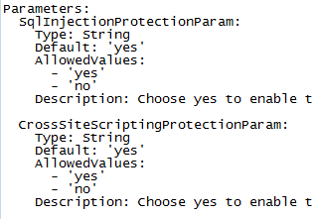
Tools in Your Arsenal-CloudFormation
Traits
AWS WAF Example
Simple, declarative
Editable with your fav text editor
Available from your fav vendors!
Notes:
If you are an AWS-centric shop, let me introduce you to your new best friend. CloudFormation templates allow you to deploy individual objects or whole application/network stacks within minutes. These are not written in PowerShell, they are written in Javascript Object Notation (JSON). JSON is a nice simple language to work with, and I enjoy it much like I do PowerShell DSC. There are hundreds of sample templates to work with to help you get started.

Slide 17
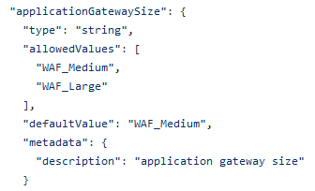
Tools in Your Arsenal-ARM Templates
Traits
ARM WAF Example
Simple, declarative
Editable with your fav text editor
Available from your fav vendors!
Notes:
If you are an Azure-centric shop, let me introduce you to your new best friends. ARM templates allow you to deploy your applications with all of their dependencies in a single template. ARM templates are written in JSON much as the AWS CloudFormation templates are. JSON is very simple to learn and use so it is nice for those organizations that might be a hybrid Azure/AWS shop since you will only need to know JSON.

Slide 18
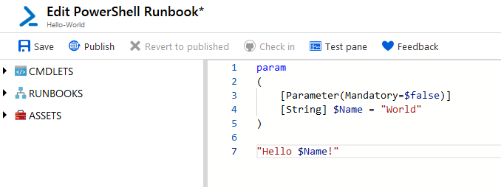
Tools in Your Arsenal-Azure Automation
Traits
Runbook Example
Editable with Azure’s graphical editor
Sample runbooks available from the Azure Marketplace
Notes:
But now for your second best friend…say you don’t know JSON. You know PowerShell, or maybe you just want to focus on PowerShell. Azure Automation to the rescue! Azure Automation allows you to create runbooks with PowerShell, or assign PowerShell DSC configurations to your existing systems. The runbooks are an exceptionally powerful tool in your arsenal.

Slide 19
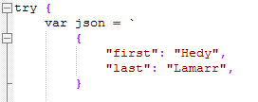
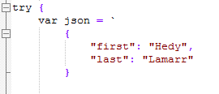


JSON Troubleshooting
Trailing comma – your arch nemesis
Notes:
As with any technology, there are some things that can go wrong when using JSON. One of the most common is leaving an trailing comma at the end. JSON uses the trailing comma to indicate that a third value is going to follow. In the first example on the left, you can see there is a comma after Ms. Lamarr’s last name. This will cause an error. The sample on the right that contains no comma after Ms. Lamarr’s name will run correctly.
Also you get extra cool points if you know who Hedy Lamarr is and why she is awesome…did you get it? She filed the patent for a frequency hopping technology. Without her, we wouldn’t have secure wifi, GPS or Bluetooth. Ok that’s the only nerd trivia for today.

Slide 20

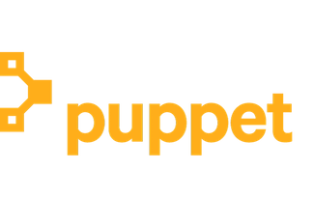
Automation Tools
Chef
Puppet
Tons of free training
Azure/AWS native support
DevOps Focus
Paid and Free Training
Azure/AWS native support
Operations/System Admin Focus
Notes:
I do want to touch briefly on a few of the automation tools you can play with in your DevOps or DevSecOps journey. Chef and Puppet are both natively supported by Azure and AWS, and are both excellent products. If you are coming at things form a DevOps focus, Chef is usually recommended for this. On the other hand, if you have more of a System Administration focus, you may find Puppet to be more your liking.

Slide 21

Recap-Tying Things Together
Automate routine tasks
You don’t have to be a developer to benefit…
You can go on vacation!
This Photo by Unknown Author is licensed under CC BY-NC-ND
Notes:
DevOps and DevSecOps can help you automate routine tasks freeing you from day-to-day chores to focus on project work and training
You don’t have to be a developer to benefit…simply using PowerShell and PowerShell DSC which you may already be using could reduce your workload.
You can go on vacation and not get called!

Slide 22
“Apply” Slide
Next week you should:
Define at least one use case where you can start using DevSecOps to improve your life
In the first three months following this presentation you should:
Get more comfortable with PowerShell and PowerShell DSC if you are not already
Play with JSON and get familiar with the syntax
Within six months you should:
Be working on your first use case…
Notes:
Next week you should:
Define at least one use case where you can start using DevSecOps to improve your life. You will probably find plenty more than just one.
In the first three months following this presentation you should:
Get more comfortable with PowerShell and PowerShell DSC if you are not already…take advantage of training and resources that are out there.
Play with JSON and get familiar with the syntax, especially if you use both Azure and AWS.
Within six months you should:
Be working on your first use case…start improving your life! Get your vacation time back!

Slide 23
Learning Resources-Videos
Pluralsight
Paths: Windows PowerShell: Essentials
Windows PowerShell Desired State Configuration Fundamentals
Automating AWS with CloudFormation
Getting Started with Azure Automation
Getting Productive with Chef Cookbooks
Paths: Configuration Management using Puppet

Slide 24
Learning Resources-Books
Learn Windows PowerShell in a Month of Lunches, 3rd Edition
By Don Jones and Jeffery Hicks
Pro PowerShell Desired State Configuration
By Ravikanth Chagani
Implementing DevOps with Microsoft Azure
By Mitesh Soni
Effective DevOps with AWS
By Nathaniel Felsen
Windows Server 2019 & PowerShell All-in-One Desk Reference For Dummies (Release date: April 30, 2019)
By Sara Perrott

Slide 25
Learning Resources-Other
Other Training
F5 NetOps Training https://f5.com/education/super-netops-training
Chef Training https://learn.chef.io/#/
Puppet Training https://learn.puppet.com/category/self-paced-training

Slide 26
Learning Resources-Tools
AWS CloudFormation
Azure ARM
AWS Sample Templates
https://aws.amazon.com/cloudformation/aws-cloudformation-templates/
Check Point Firewalls
https://supportcenter.checkpoint.com/supportcenter/portal?eventSubmit_doGoviewsolutiondetails=&solutionid=sk111013
Palo Alto Firewalls
https://github.com/PaloAltoNetworks/aws
Azure Sample Templates
https://azure.microsoft.com/en-us/resources/templates/
Palo Alto Firewalls
https://github.com/PaloAltoNetworks/azure
Cisco Firewalls
https://github.com/cisco-security/public-cloud
Notes:
Put link text in

Slide 27
Q&A
Sara Perrott
saraperrott@icloud.com
Twitter: @PerrottSara
https://www.saraperrott.com
https://github.com/sara-perrott/RSAC2019

